Slide 1
Budget Sales Analytics
-DEVIKA BABU KADAVIL

Slide 2
Objective
This project is to analysis the Customer data, Product data, Sales data and Budget Data of a Retail chain and extract keys insights that can be valuable in taking business decisions

Slide 3
Dataset Information
This dataset contains various tables:
Budget Data: Contains the features of the sales of budget year 2016.
Customer Data: Contains features regarding the customers.
Sales Data: Contains the features regarding the sales of the products.
Territory Data: Contains the features of the territory of the sales.
Product Data: Contains the features of the products sold.

Slide 4
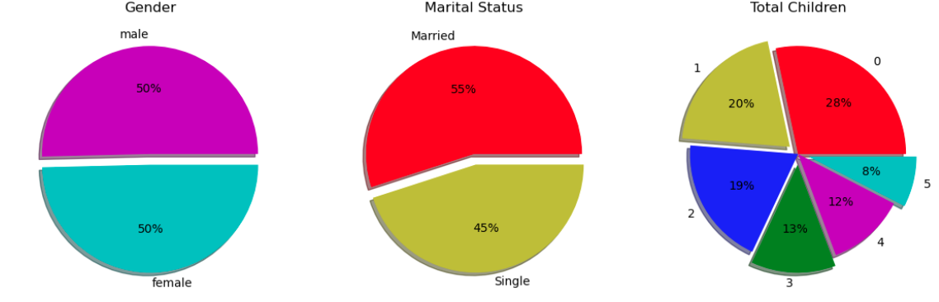
Customer data
Plotting the pie charts to know what is the proportion of customers according to marital status , Gender and how many total children they have
So, there is no difference between the male and female.
There are equal males and female customers but are more married customers with 0 children.

Slide 5
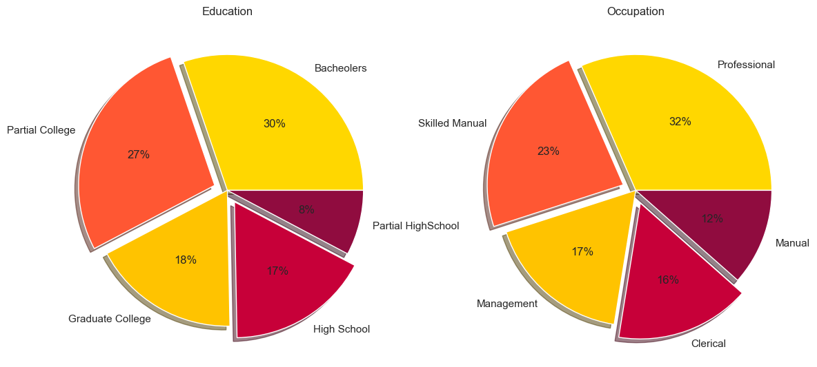
Customers Occupation and Annual income
This shows that most customers are from professional background and with a bachelor's education

Slide 6
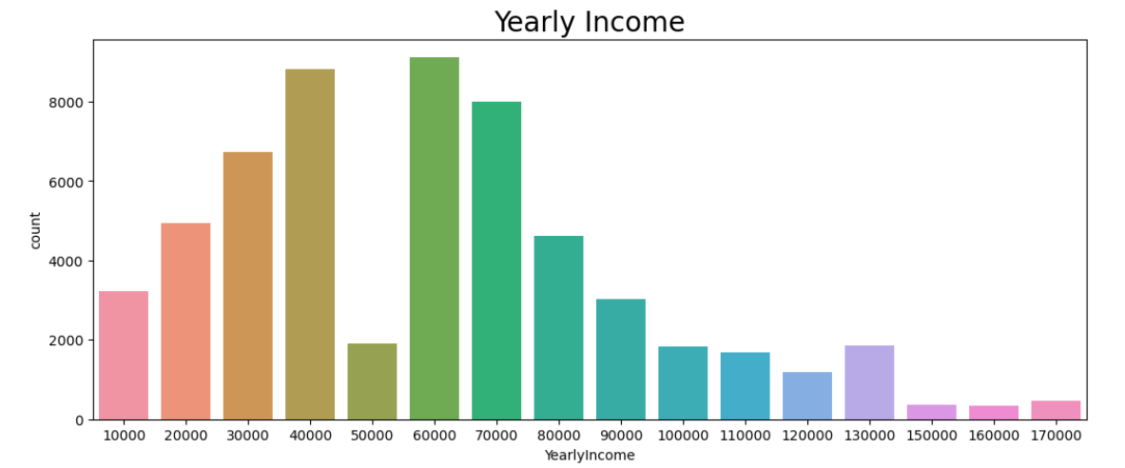
Annual income
The most customers are those who have an annual salary between 35000-70000 while those with an annual salary of 50000 are less.

Slide 7
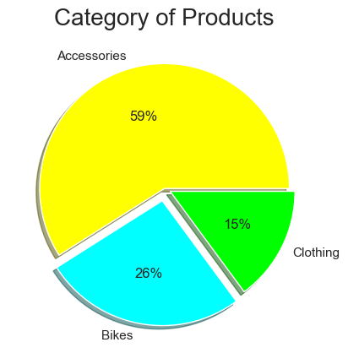
Category of product
This shows that the 59% of the purchase of accessories

Slide 8
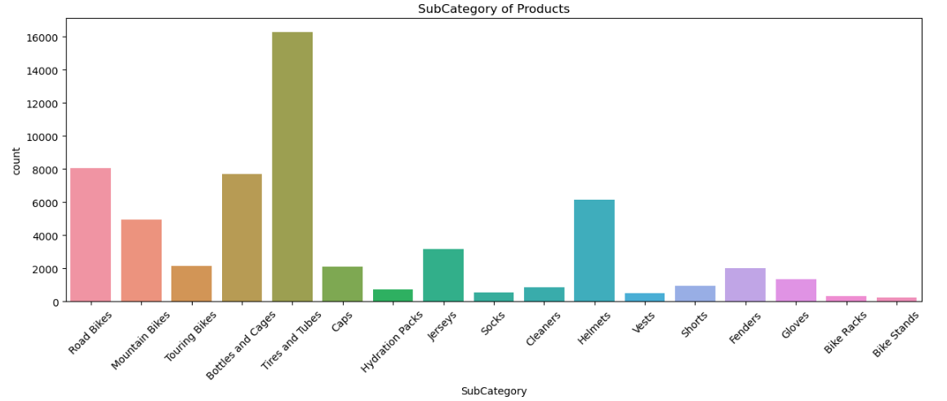
Subcategory of product
Tiers and Tubes are purchases the most followed by the Road Bikes and the lest sold category of product is Bike stands

Slide 9
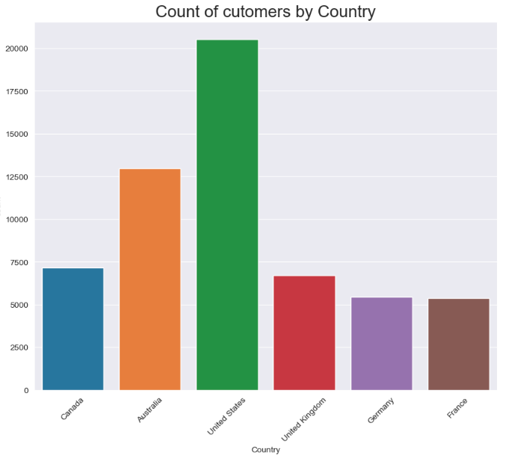
Count of customers by countries
The most number of the customers comes from the U.S
And the least are from France and Germany

Slide 10
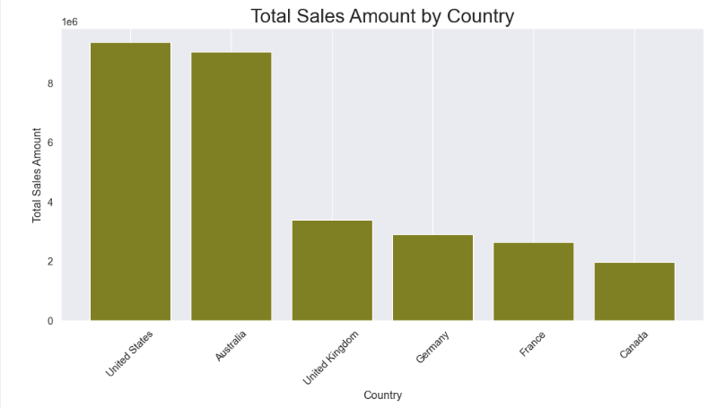
Total Sales amount by country
According to the plot we know that the most amount of sales comes from U.S and though the number of customers in Canada is more the amount is less

Slide 11
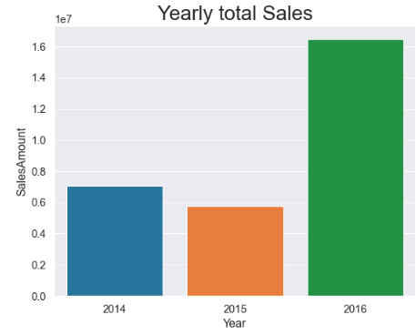
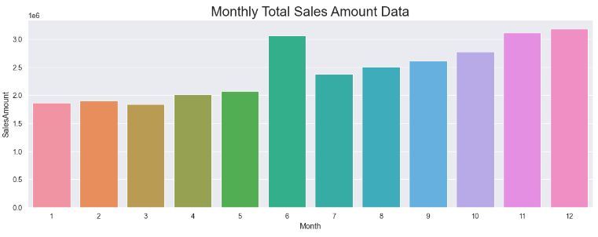
Total Sales
Yearly Total Sales
Monthly Total Sales
The most amount comes in the months of December , November and June and it gradually increases from Jan to Dec
The most sales are done in the year 2016.

Slide 12
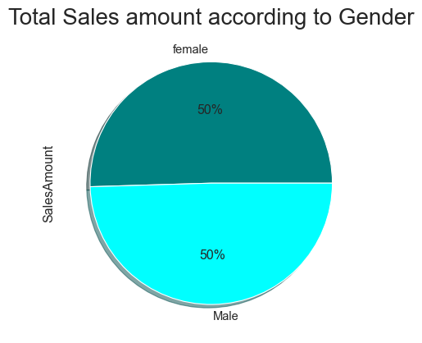
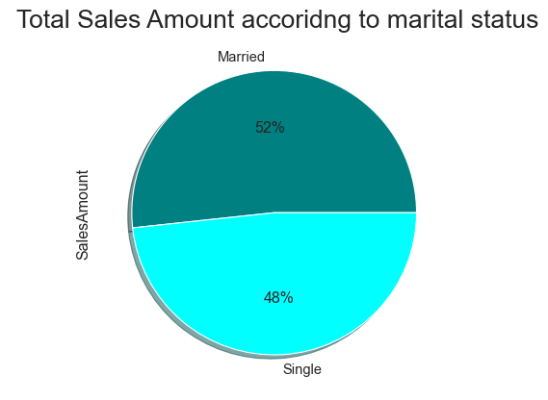
Customers Gender and their Marital status
Gender
Marital status

Slide 13
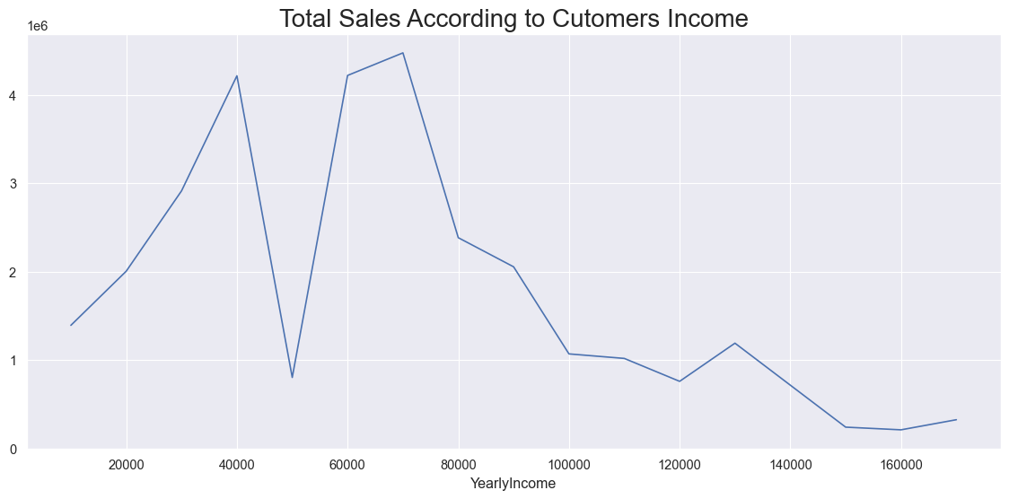
Total sales according to customers income
The above plot shows that the most customers are with a annual income of range between 35000 - 80000 and also the most amount from the same customers

Slide 14
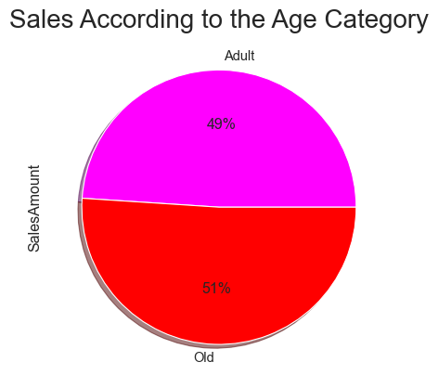
Sales According to Age Category

Slide 15
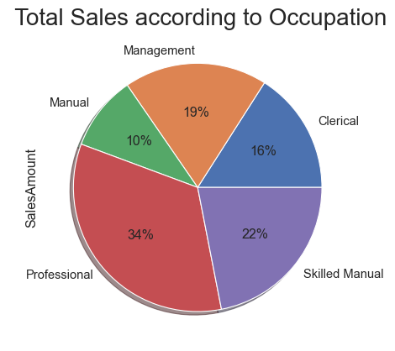
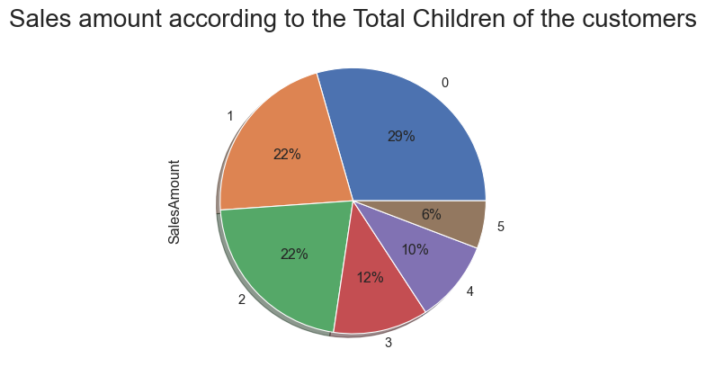
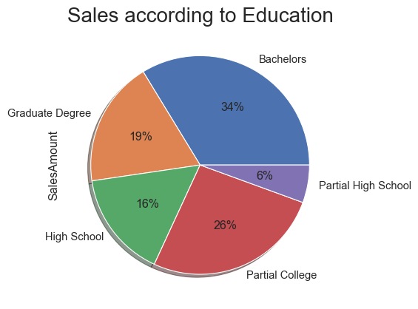
Total Sales According to their Occupation, children, Education

Slide 16
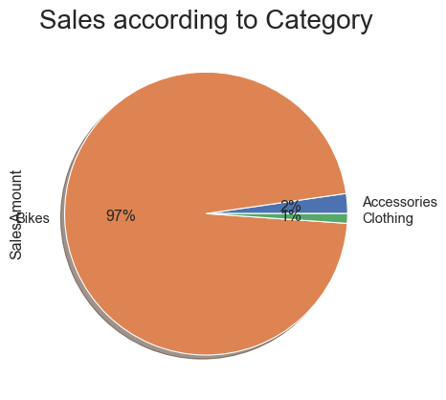
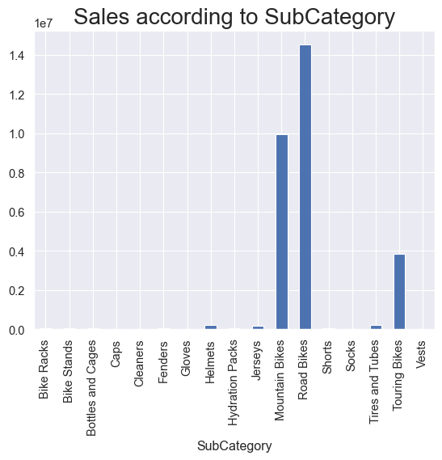
Sales According to Category and Subcategory

Slide 17
Thank you!

